Slide 1
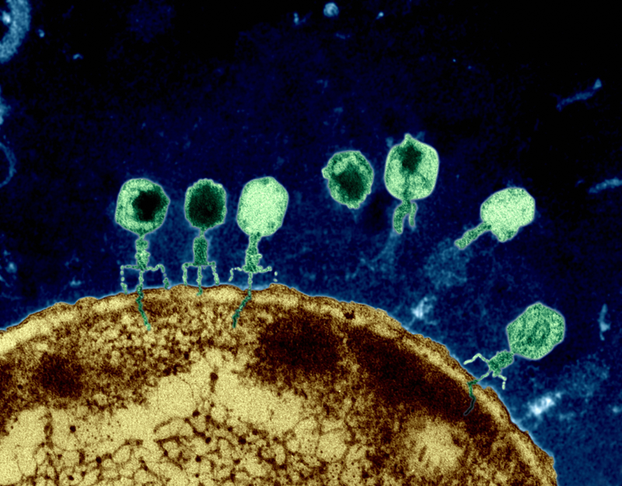
http://www.1ohww.org/first-accurate-simulation-of-a-virus-invading-a-cell/

Slide 2
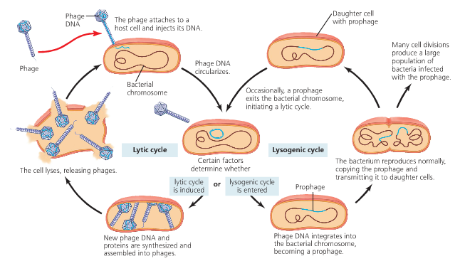

Slide 3
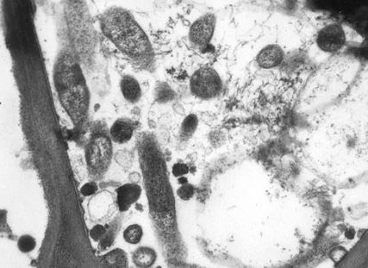
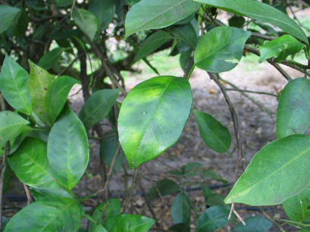
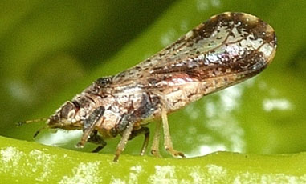
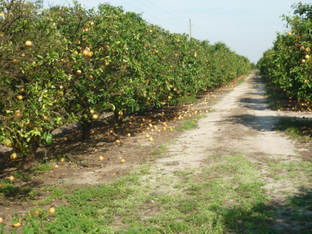
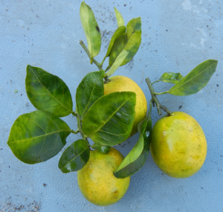
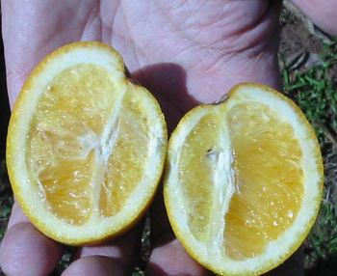
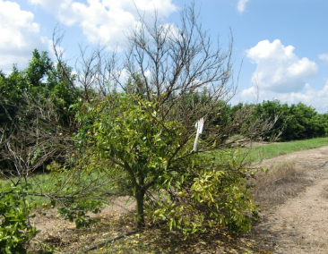
Obligatory perfunctory information on HLB
HLB is Devastating the Florida Citrus Industry
Courtesy of Dr. McCollum

Slide 4

HLB research is challenging
Host
Perennial
Large
Space
Non-uniform
Vector
Insect (!#?#$)
Rearing
Behavior
Pathogen
Insect-vectored
Phloem-limited
Uneven distribution
Detection?
Courtesy of Dr. McCollum

Slide 5
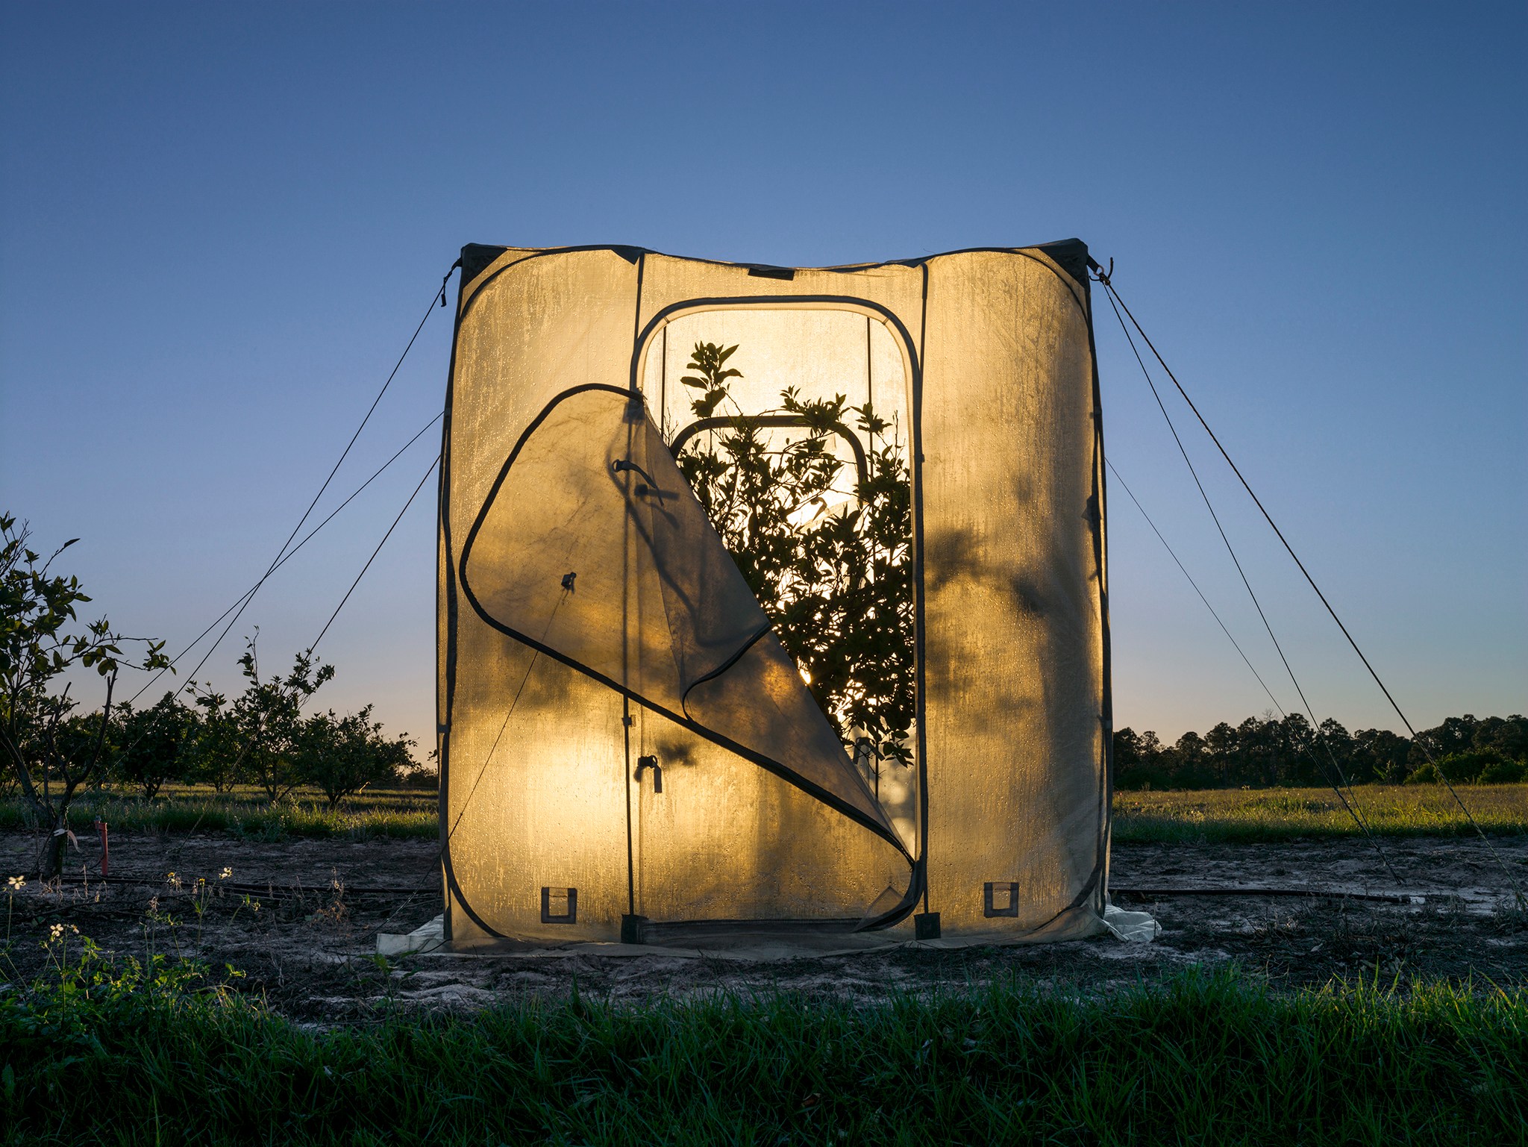

Slide 6
Proposed experiments
Use E. coli that contains a prophage and expose it EM waves
Variables time, power, and frequency
Measure the amount of phages and E. coli cells 2 ways
qPCR measures the abundance of a specific gene
Platting
Inoculate E. coli in lettuce and then expose inoculated lettuce to EM wave

Slide 7
Proposed experiments
Repeat the first experiment with Ralstonia solanacearum a plant pathogen
First in media
In planta
Then move into Citrus

Slide 8
Questions
How do we determine which frequency?
How do we determine the power and time?
How do we expose the bacteria to the EM?
Is the EM wave specific to strain, species, genus, or all bacteria?

